Slide 1
Broken Access Control
Maryam Bibi 22844
Farida khanum 22836
Saim
Teesha
Muhammad Umer

Slide 2
Background
Broken access control is a critical security vulnerability that can lead to unauthorized access to sensitive information and functionalities within a system. This report discusses the development of a specialized cookie software designed to detect broken access control issues.

Slide 3
Requirements
Flask: Flask handles the web server functionality and HTTP request/response cycle.
pymongo: It is used for storing/retrieving data related to access control.
Flask-Mail: It is used to send notifications/alerts about access control issues in your application.
Burp suit
Vercel
Notes:
Flask: Flask is a Python web framework used for building web applications. In the context of our broken access control detection project using cookies, Flask handles the web server functionality and HTTP request/response cycle.
pymongo[srv]: PyMongo is a Python driver for Mongo DB, a NoSQL database. The [srv] part indicates support for the SRV record, which is relevant for connecting to Mongo DB instances. In our scenario, it is being used for storing/retrieving data related to access control.
Flask-Mail: Flask-Mail is a Flask extension for handling email functionality. It's used for sending emails from a Flask application.
While not directly related to access control, it is being involved in sending notifications or alerts about access control issues in your application to the email address.

Slide 4
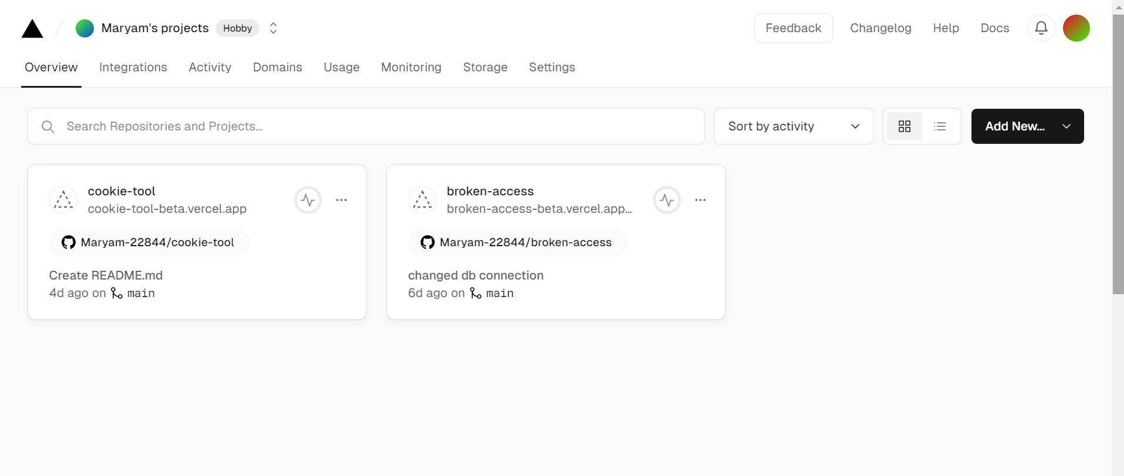
Vercel
Vercel excels at hosting front-end applications and server less functions.
Used it to detect and address broken access control through cookies in a Flask application.

Slide 5
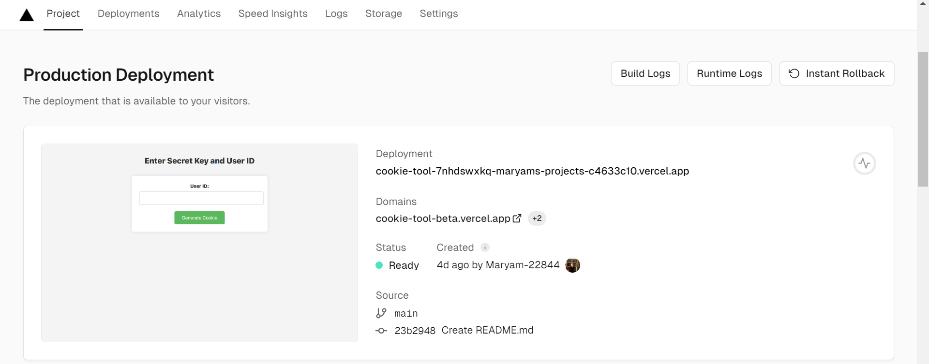
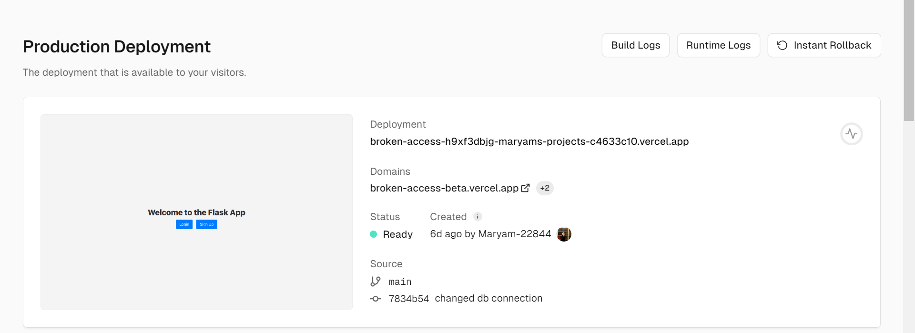
When you click on them from vercel it will take the users to this
Cookie tool
Broken access

Slide 6
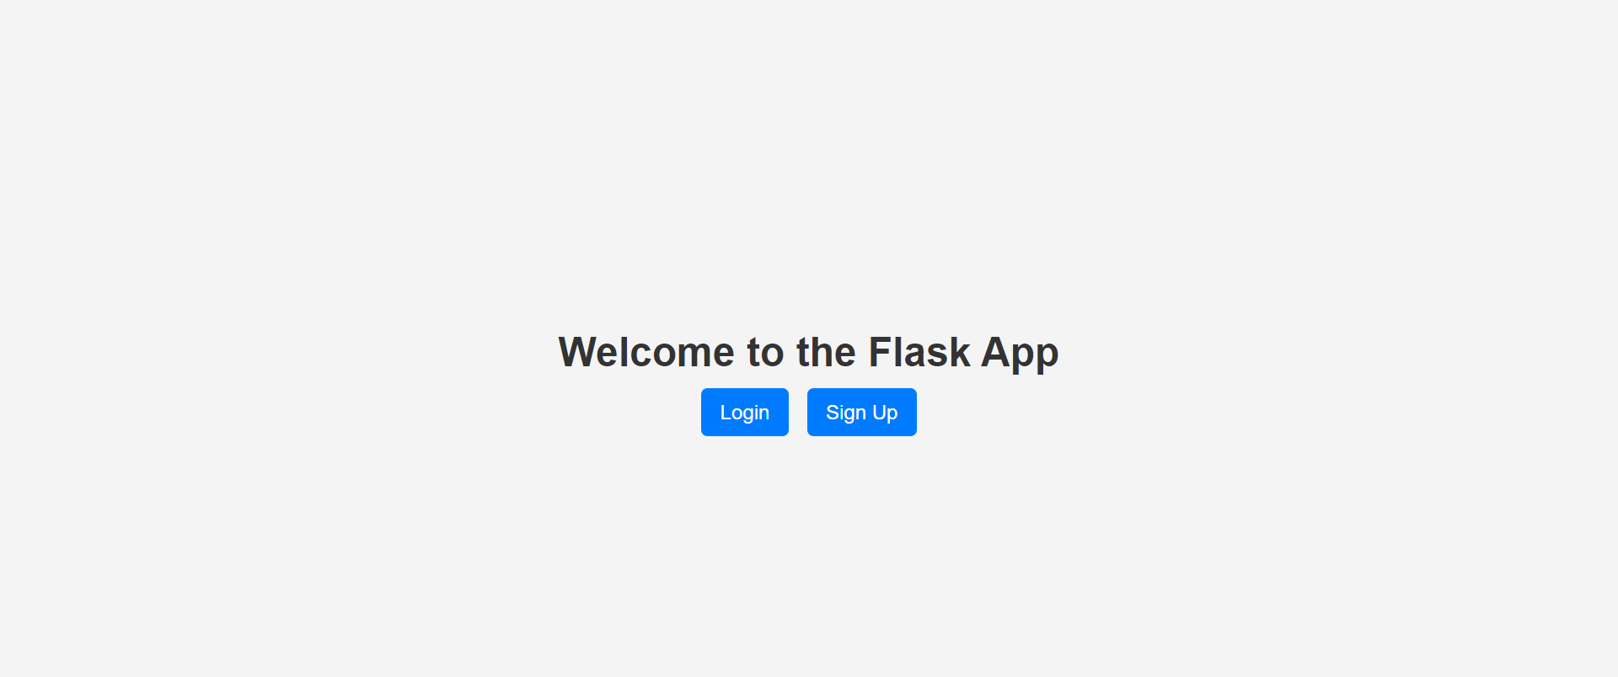
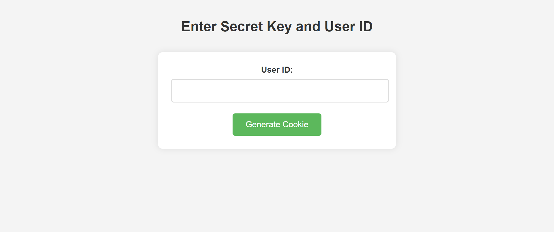
It will then take you these
Welcome page
It will be used to exploit it

Slide 7
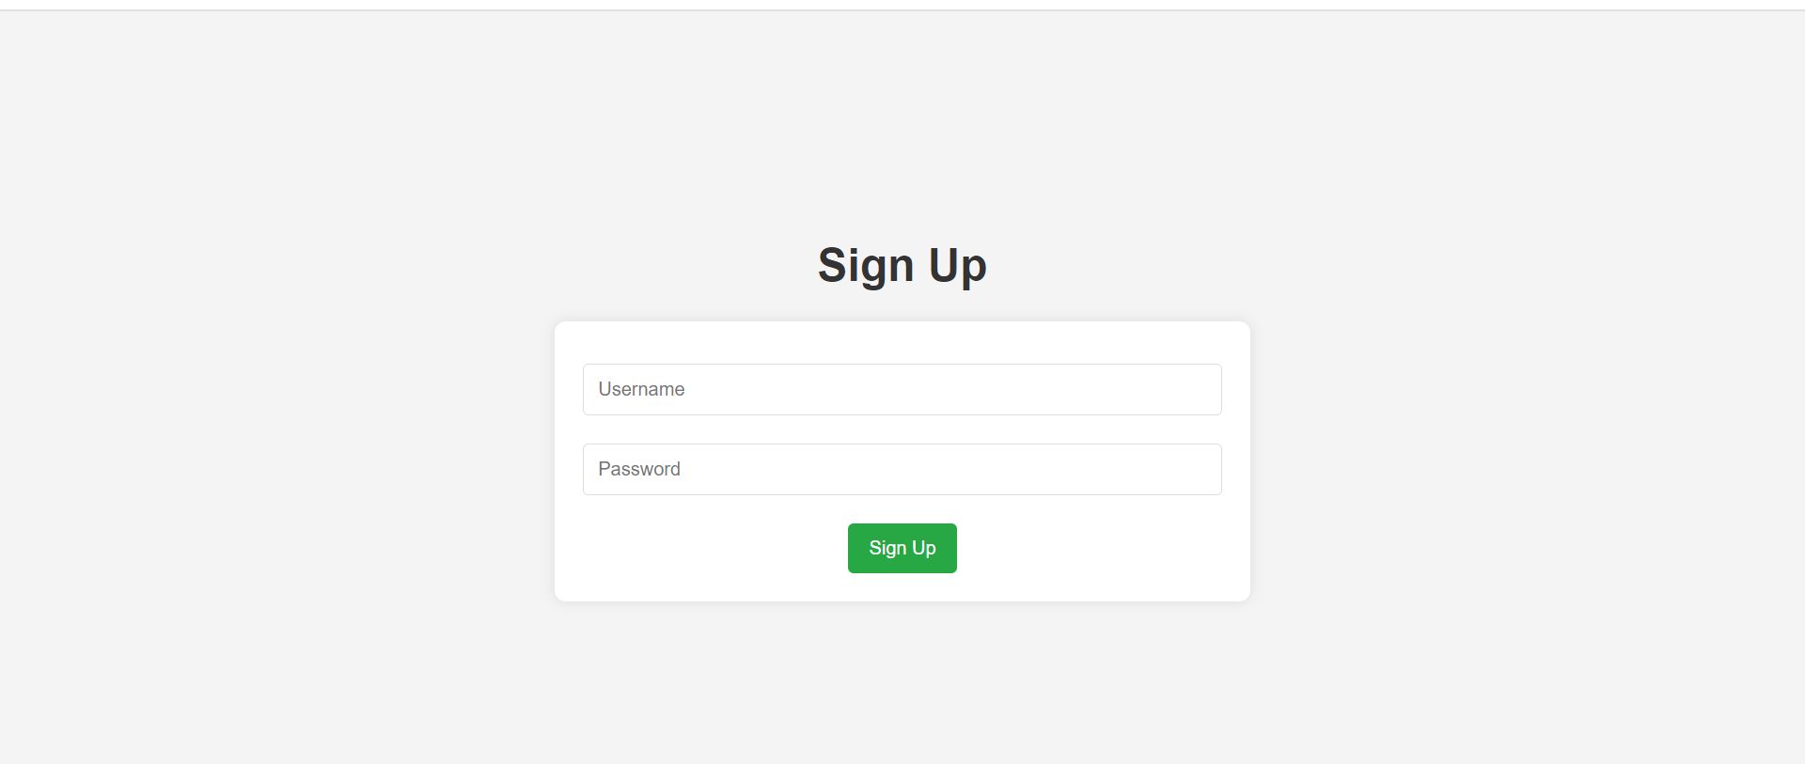
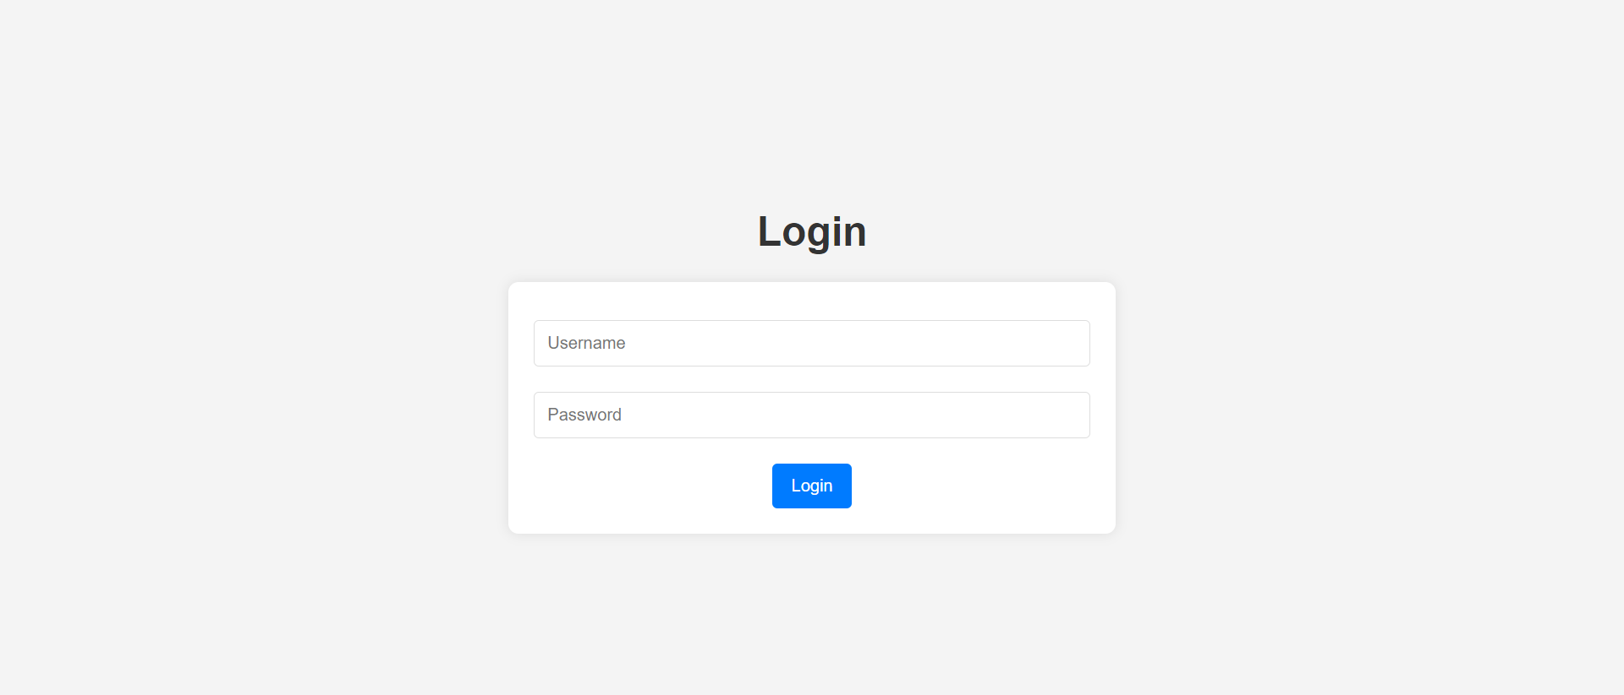
Log in and sign up page
Notes:
Here we will make an admin user which password is admin and a normal user which password is normal.

Slide 8
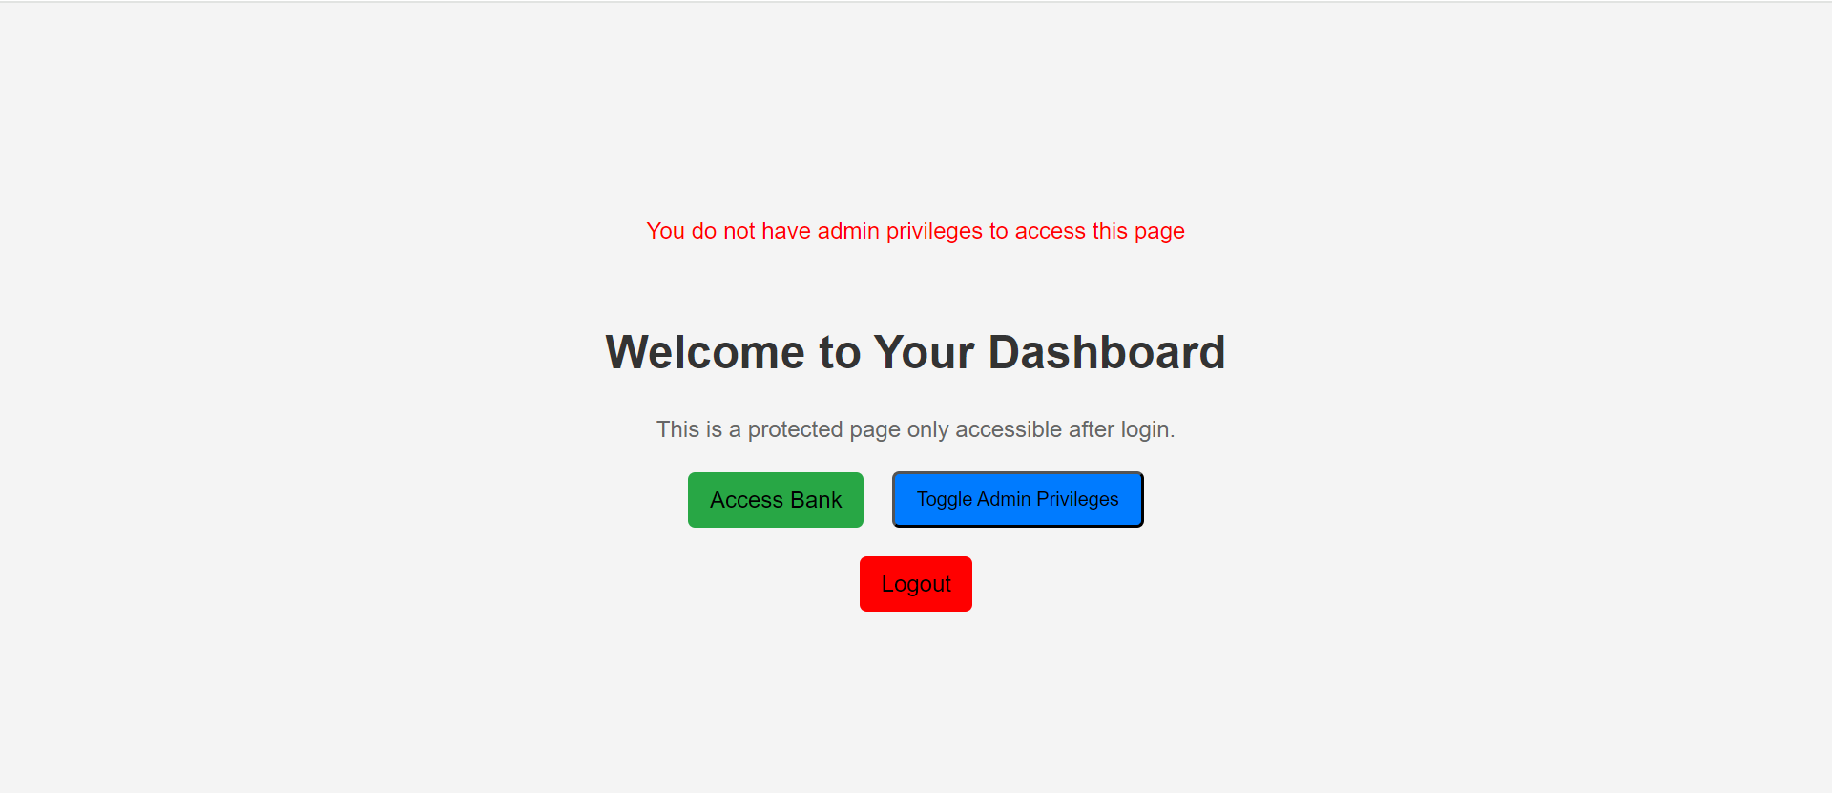
When admin log in
When admin try to access the bank then it shows that “You do not have admin privileges to access this page” feedback.
It means that admin has not been granted access to this.
To give access to this to admin we will click on toggle admin privileges.

Slide 9
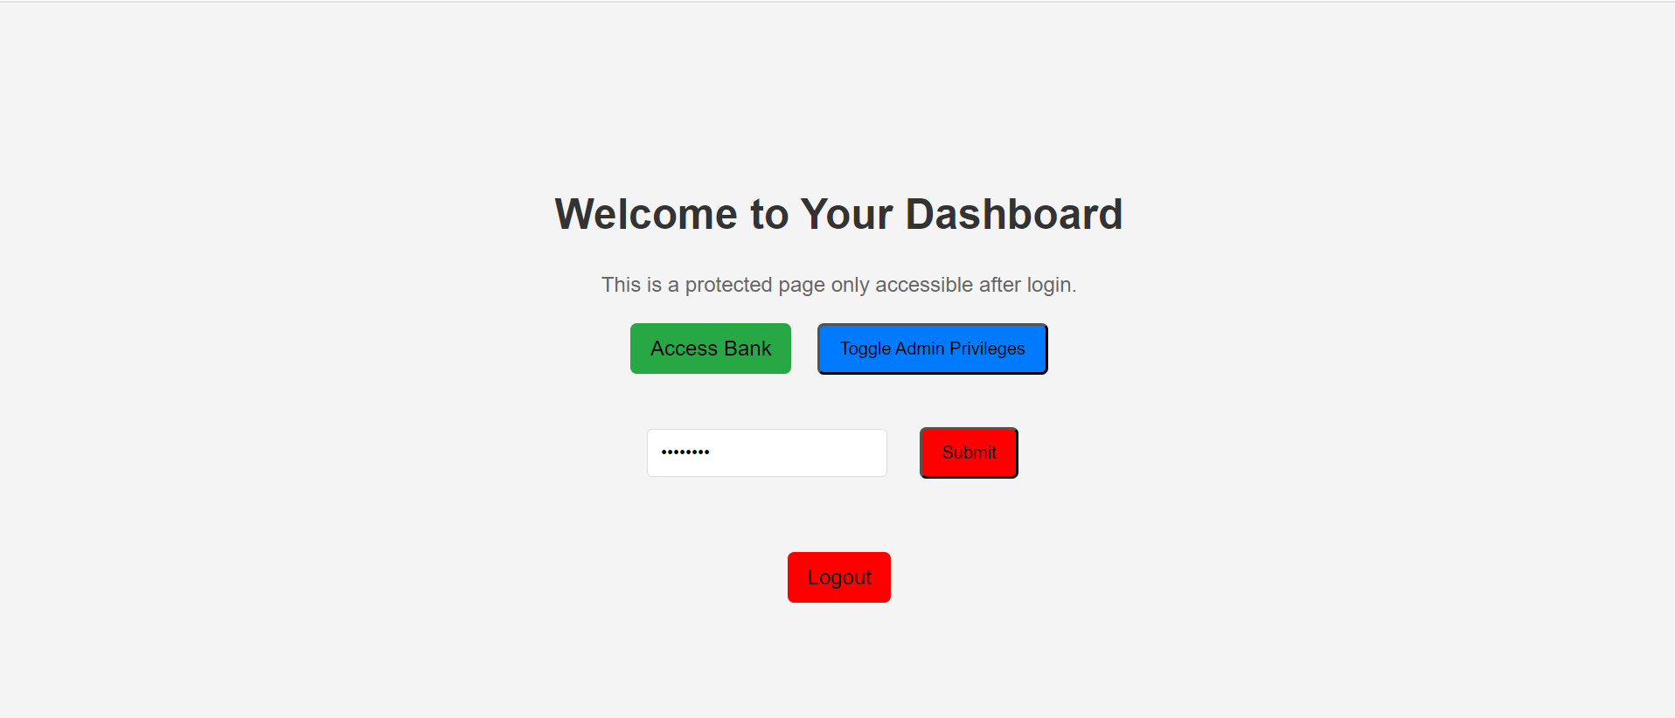
Dashboard
Here we do give the right to admin to access the bank by providing the password “password”.
After clicking on submitting, now the admin can access bank.

Slide 10
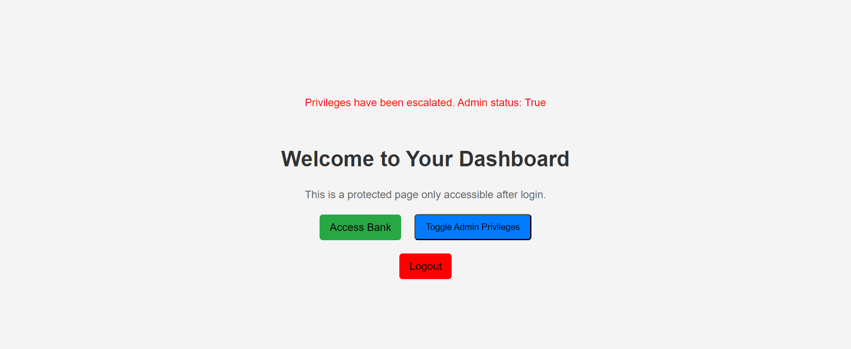
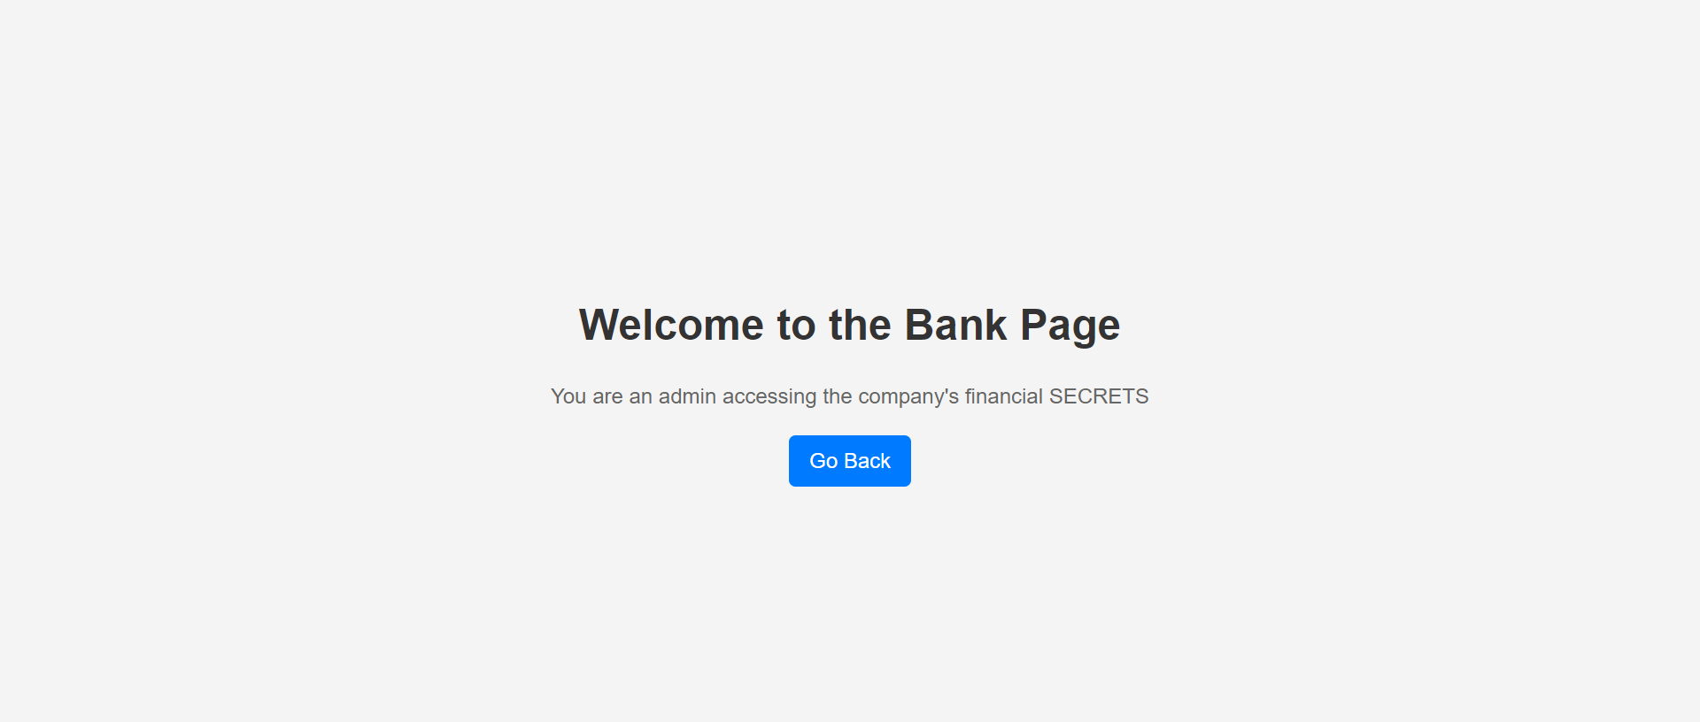
Continue….
Admin status: true
Can access the bank page

Slide 11
Normal user
When normal user is trying to access the bank page it does not give access to that.

Slide 12
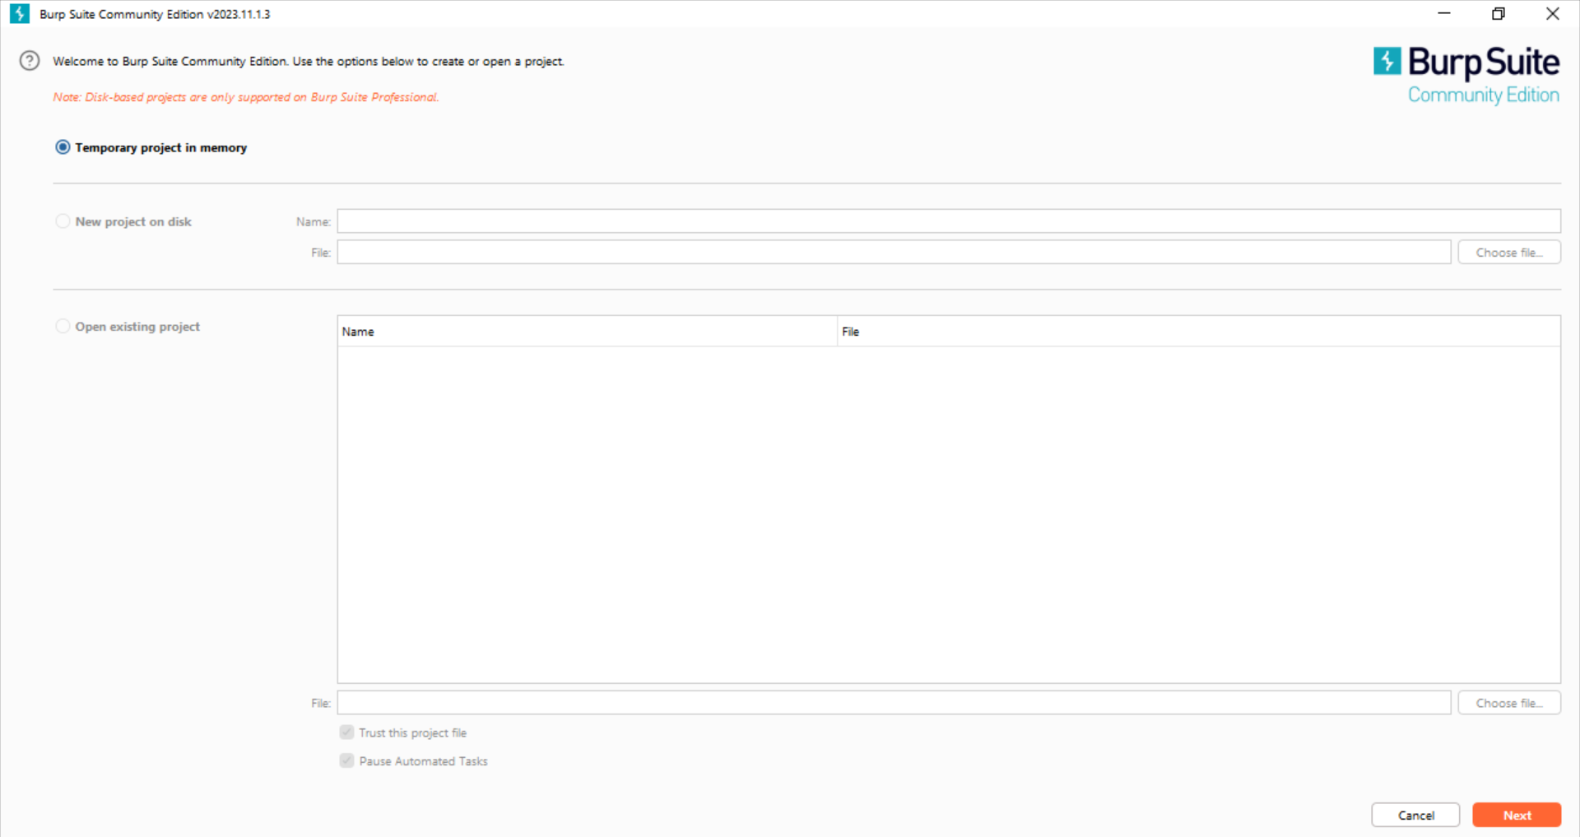
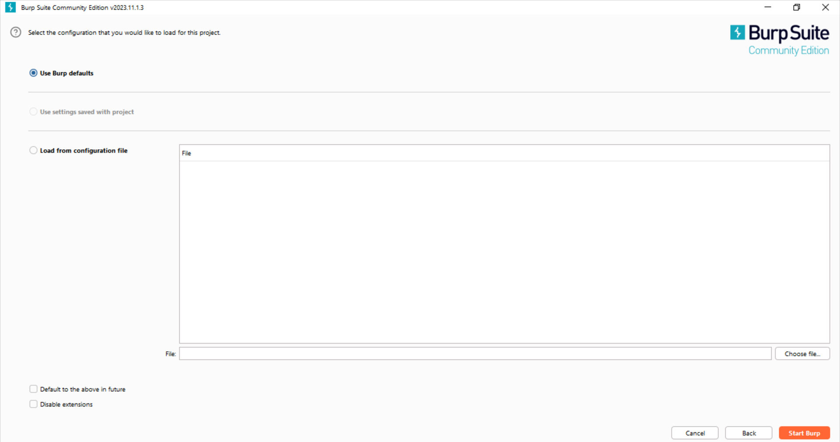
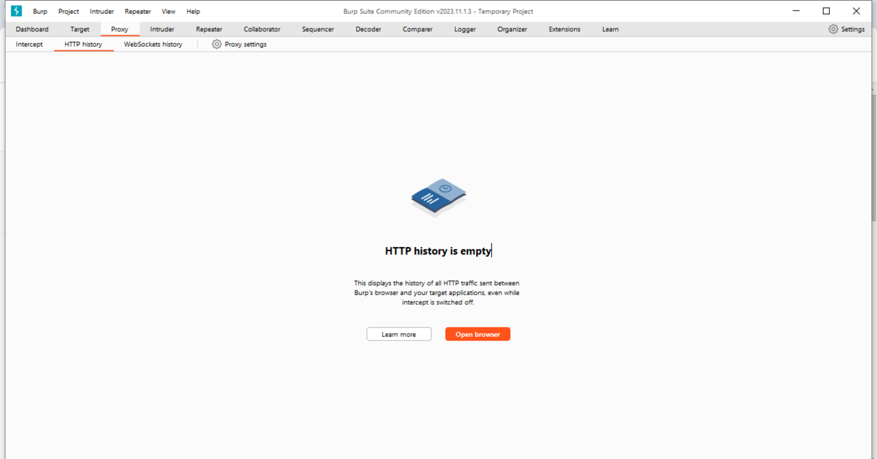
BURP SUIT STEPS
1. Click next
2. Click on start project
3. Click on Open Browser

Slide 13
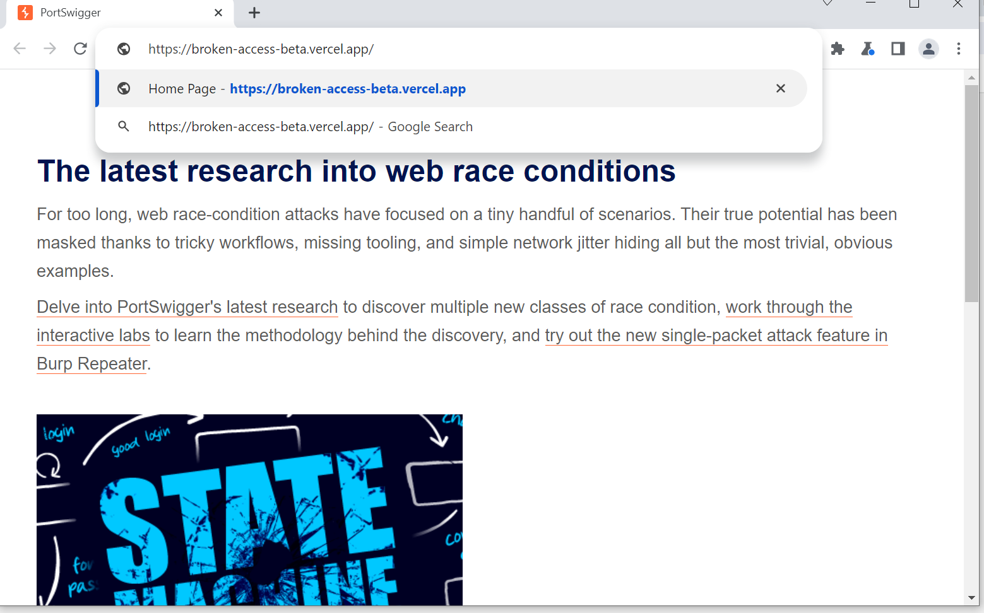
Then after step 3 from the previous slide it will open this
Here we have to copy paste the https of the dashboard and click enter.

Slide 14
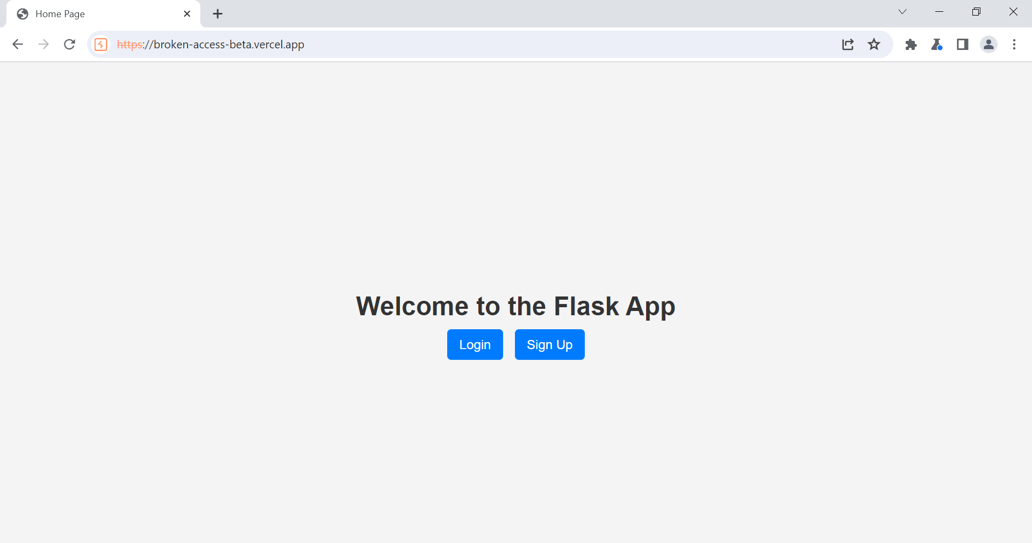
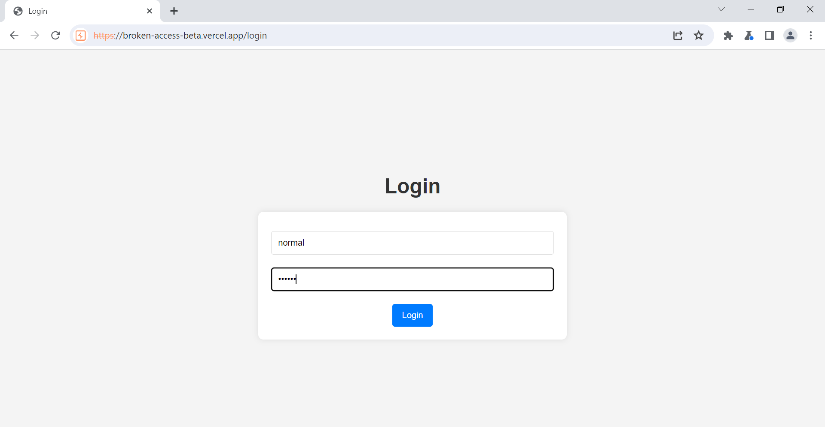
Continue…
It will open this
Normal user login

Slide 15
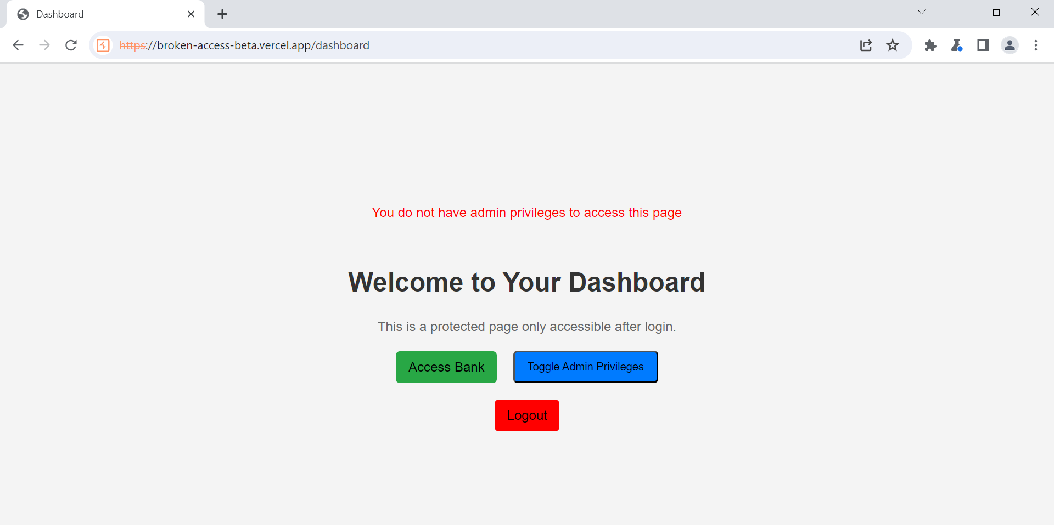
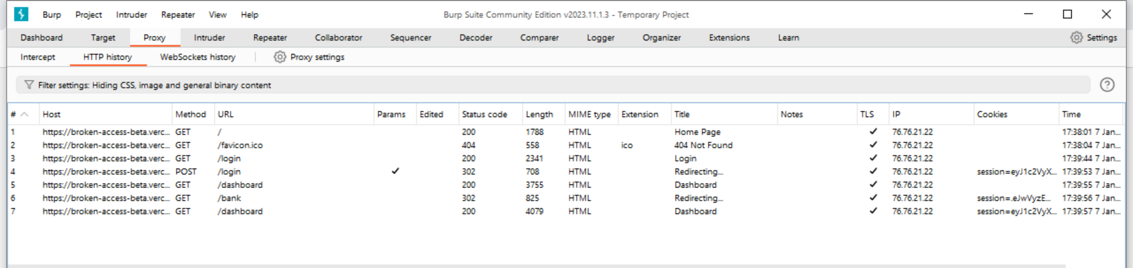
Continue..
Normal user trying to access bank
Then you can see the bank page is redirecting because normal user can not access it

Slide 16
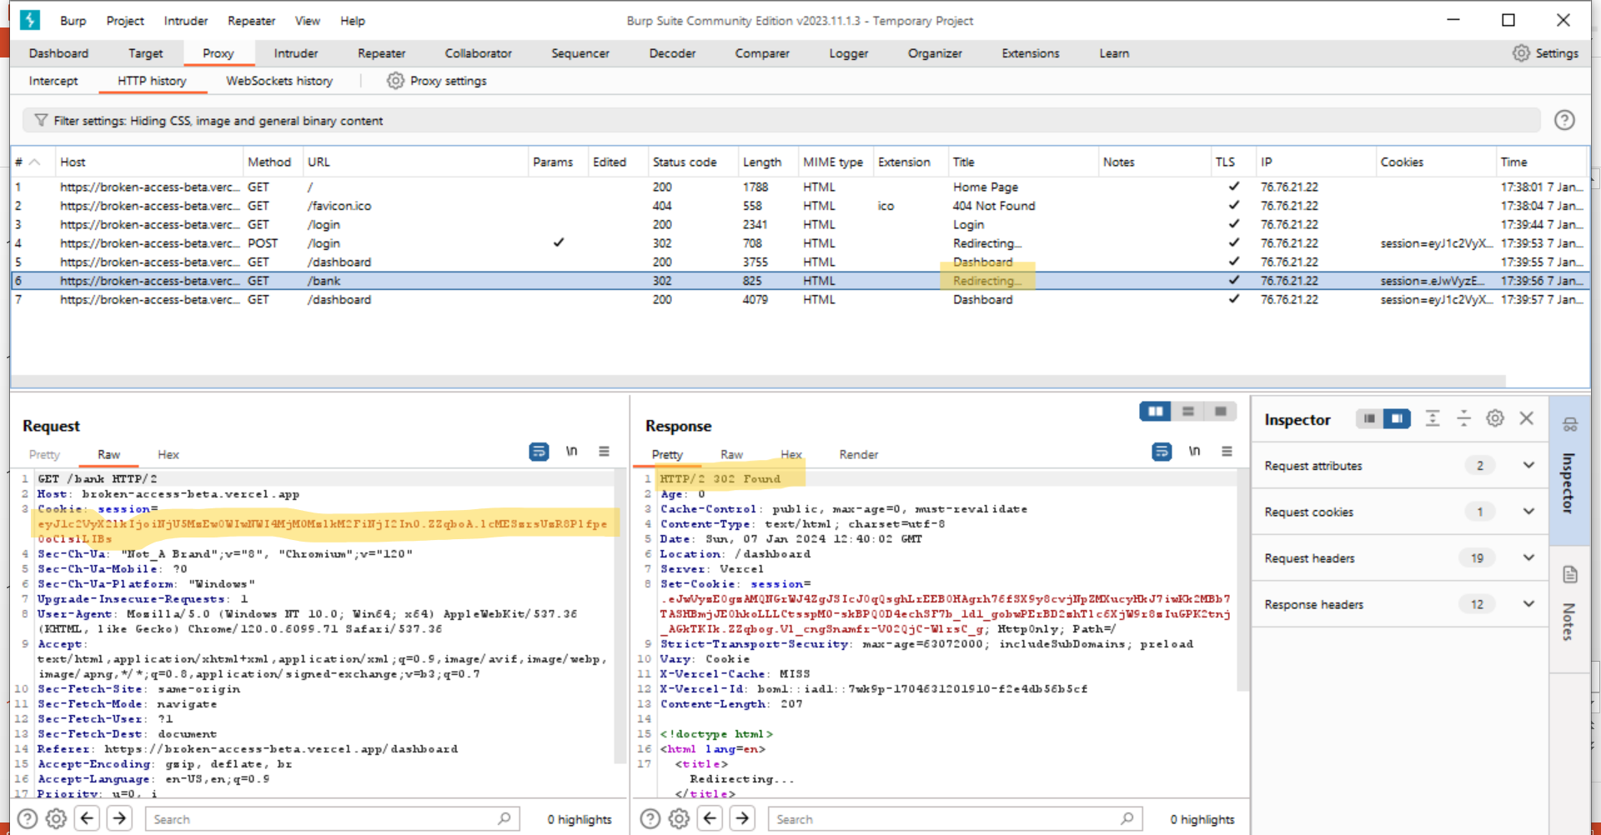
Continue…
As you can see in the response it is saying not found because normal user does not have access to it and in the request are it is the id. Which is essential for us because by using it we will exploit it.

Slide 17
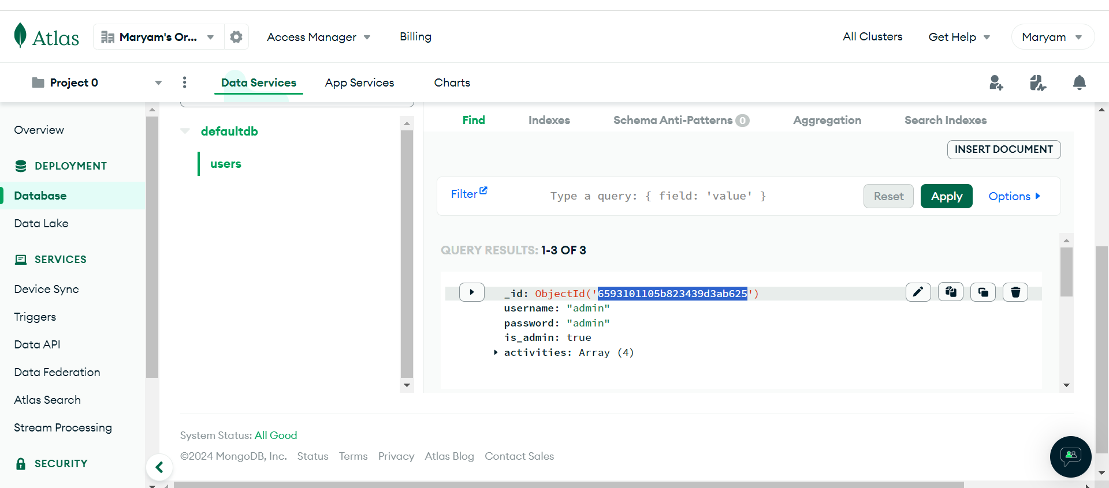
Cookie generator
We will use this id in the database to generate a cookie by the side cookie tool

Slide 18
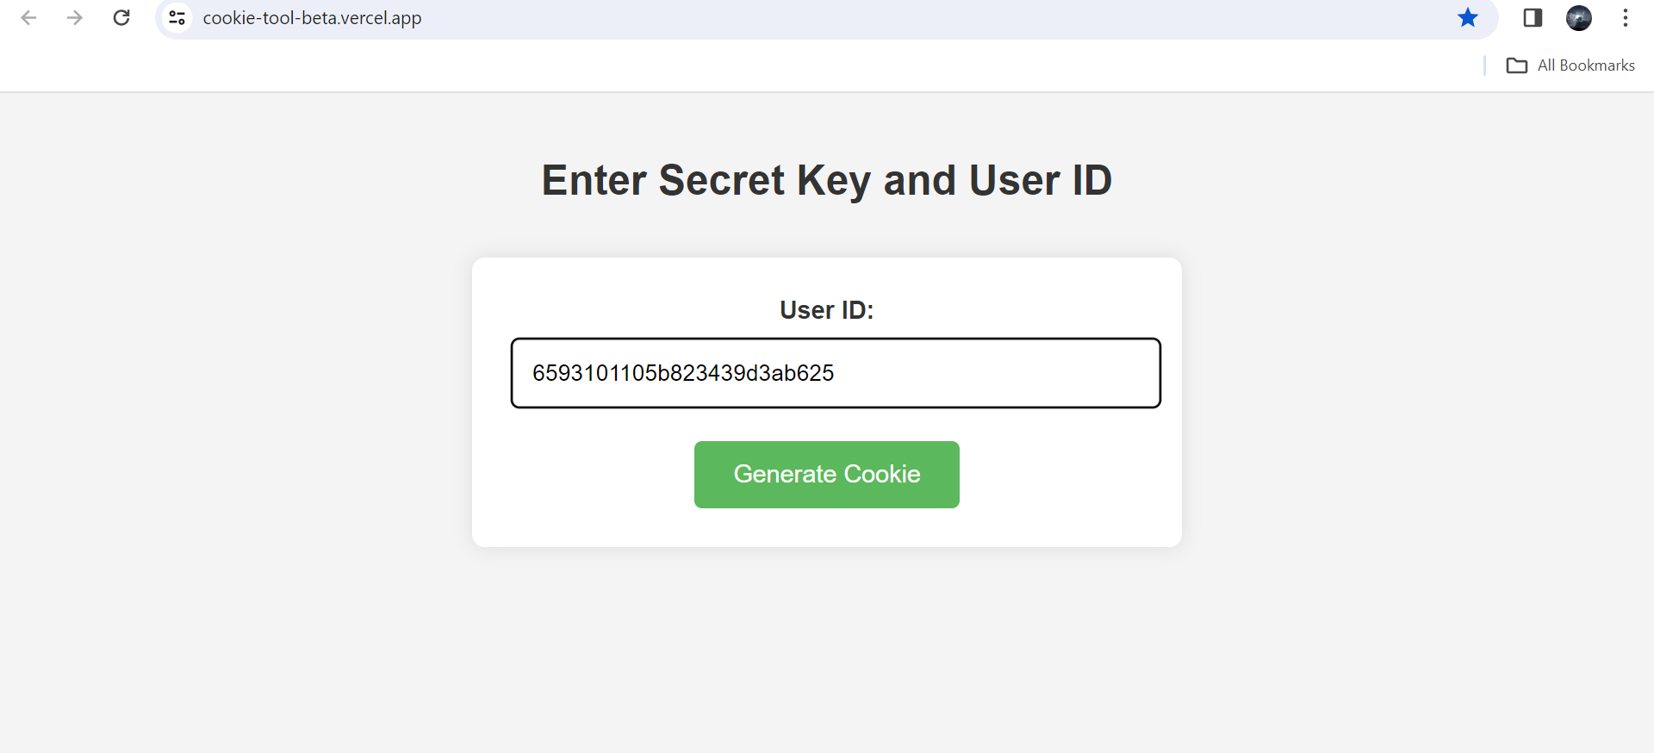
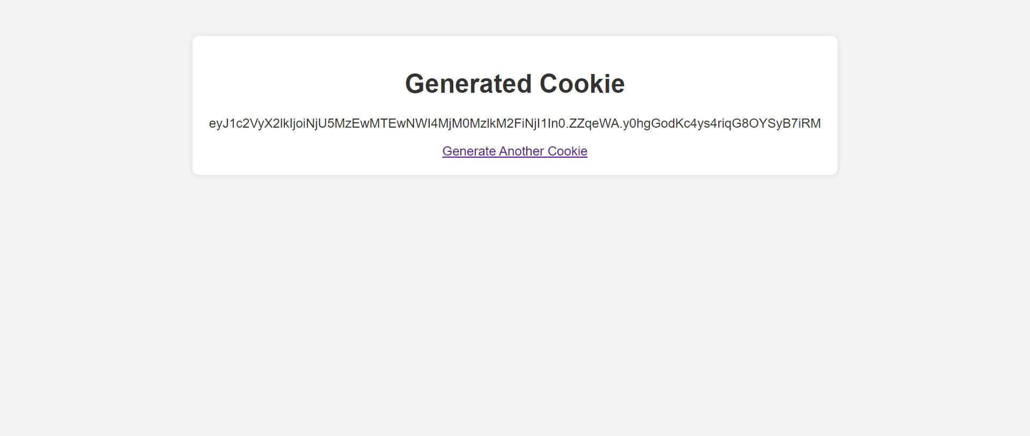
Continue…
Enter the id of admin in it
Cookie generated

Slide 19
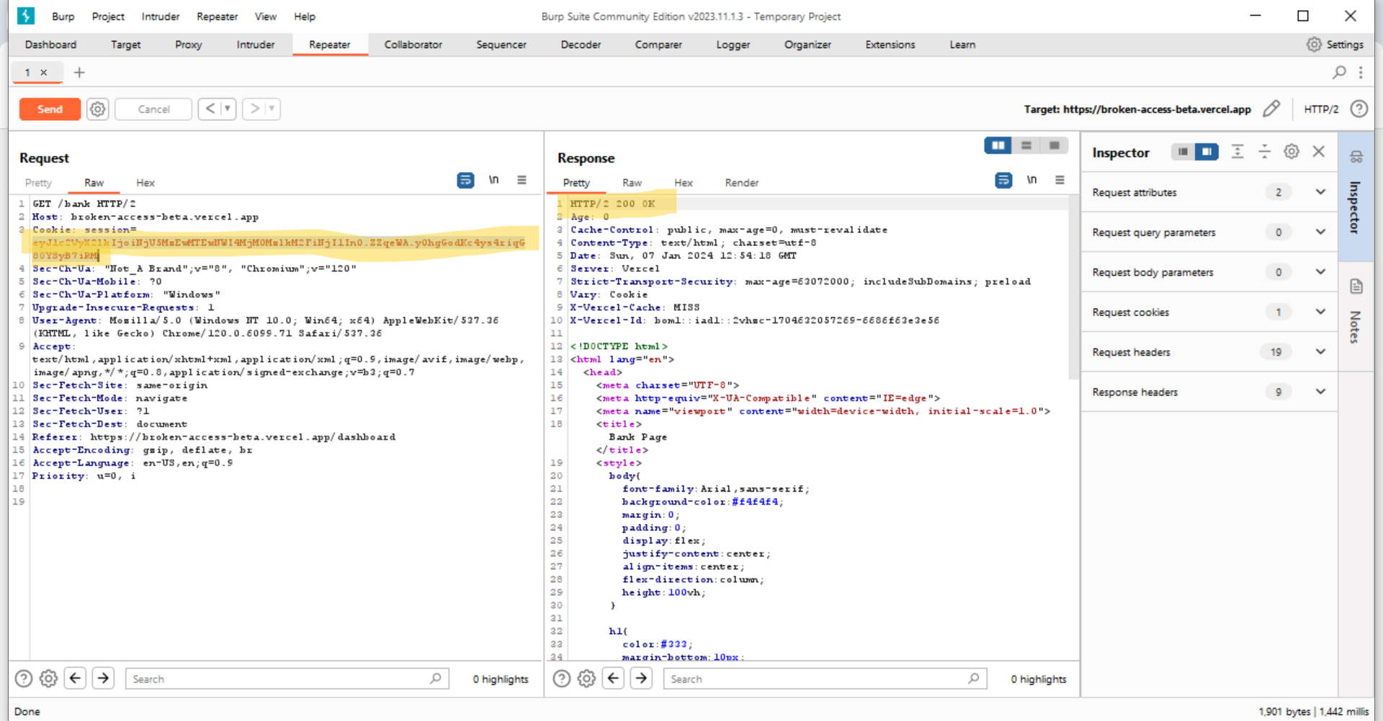
Continue…
Copied the generated cookie in the request highlighted area then click on send (orange button) and then we will get it in the response “200 OK”. It means normal user got the access to the bank page.

Slide 20
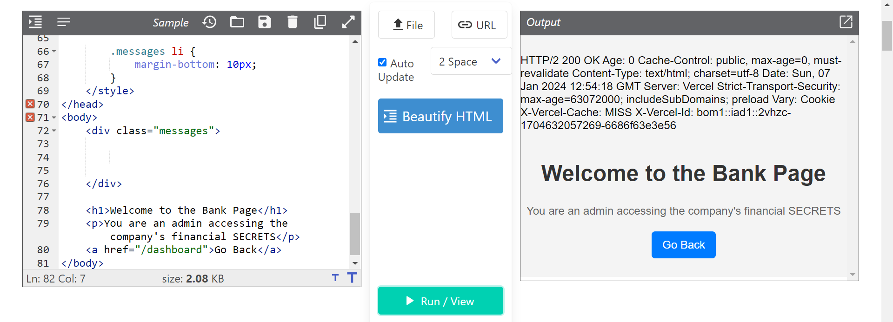
It can be accessed…

Slide 21

Thank you

